Slide 1
ChibiOS/RT Demo
A free embedded RTOS
http://www.chibios.org

Slide 2

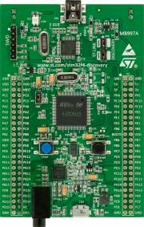
STM32F4-Discovery
STM32F407VGT6
LQFP100 package
1MB Flash, 192KB RAM
On-board STLink V2 debugger with dedicated USB port, also usable to debug external devices like a standalone debugger
OTG micro USB connector connected to the OTG-FS peripheral
8 LEDs, both user and dedicated
Reset and User buttons
On-board LIS302DL MEMS accelerometer
On-board MP45DT02 MEMS microphone
On-board CS43L22 audio CODEC connected to audio jack
All peripherals supported by ChibiOS/RT

Slide 3
STM32F4
ARM 32-bit Cortex™-M4 CPU with FPU
Adaptive real-time accelerator (ART Accelerator™) allowing 0-wait state execution from Flash memory, frequency up to 168 MHz
3×12-bit, 2.4 MSPS A/D converters: up to 24 channels and 7.2 MSPS in triple interleaved mode
2×12-bit D/A converters
16-stream DMA controller with FIFOs and burst support
Up to 17 timers: up to twelve 16-bit and two 32-bit timers
Up to 140 I/O ports with interrupt capability
3 x I2C, 4 x USARTs, 2 x UARTs, 3 x SPIs, 2 x CAN interfaces
SDIO interface
8- to 14-bit parallel camera interface
FSMC external memory bus

Slide 4
Introducing Chibi Studio
Chibi Studio is a complete development environment for ARM
Eclipse Juno 4.2 classic with the following optional components installed:
  Eclipse CDT 8.1.0
  C/C++ GDB Hardware Debugging 7.0.0
  Eclipse XML Editors and Tools 3.4.0
  Target Management Terminal 3.3.0
  Serial Connector
  ChibiOS/RT debug plugin 1.0.8
  ChibiOS/RT configuration plugin 1.1.0
  Embedded Systems Register View plugin 0.2.1.90
  GCC ARM toolchain gcc-arm-none-eabi-4_6-2012q2-20120614
  YAGARTO Tools
  OpenOCD 0.6.0-rc2
  ChibiOS/RT 2.5.0

Slide 5

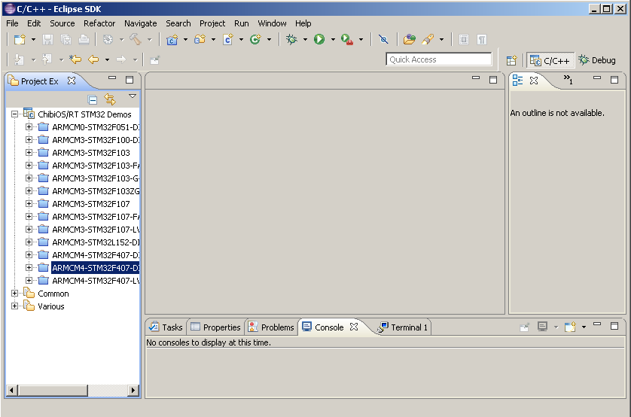
Running Chibi Studio
Run the toolchain through the desktop icon
You will find yourself into and Eclipse environment configured with several projects already imported and ready to use

Slide 6
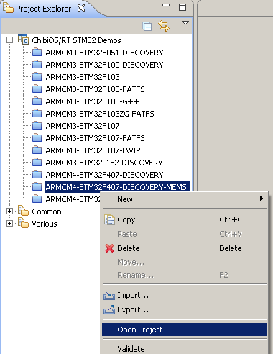
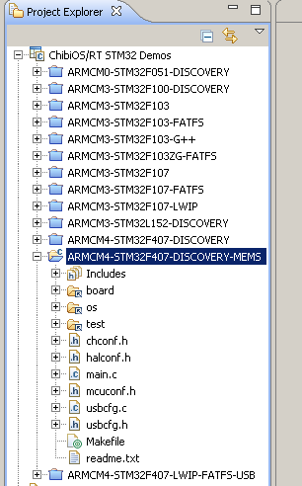
Opening a Project
Now right click on the project and select “Open Project”, the project tree will be shown, you can close the project in the same way

Slide 7
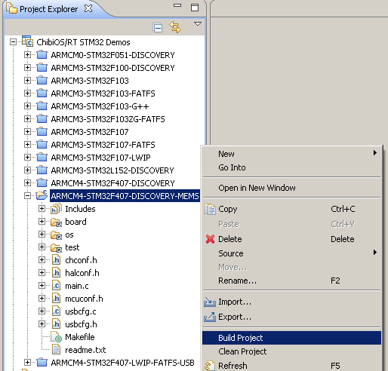
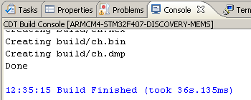
Building and Cleaning
Building and cleaning the project is very simple, all is done via the contextual menu, the Makefile is transparent to the user

Slide 8
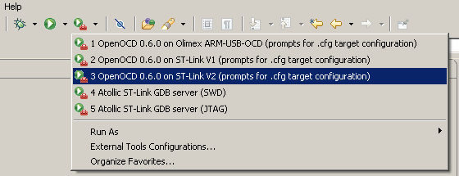
Debugging #1
First we need to run a GDB server, ChibiStudio has several options already configured
More options can be added using “External Tools Configurations…”

Slide 9
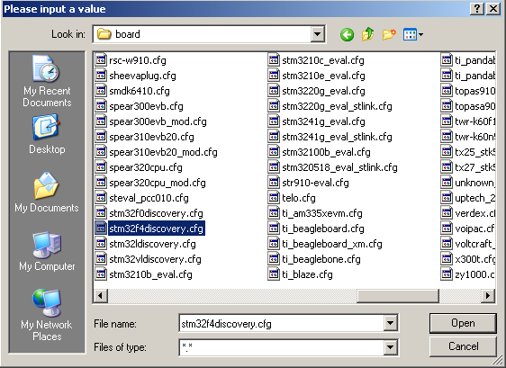
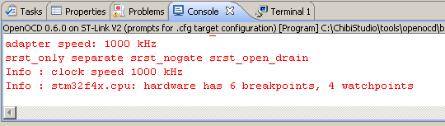
Debugging #2
Now the tool prompts for the configuration file specific for the board, note the path is C:\ChibiStudio\tools\openocd\scripts\board

Slide 10
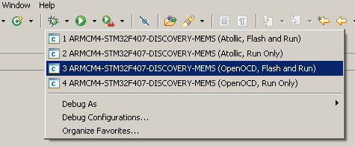
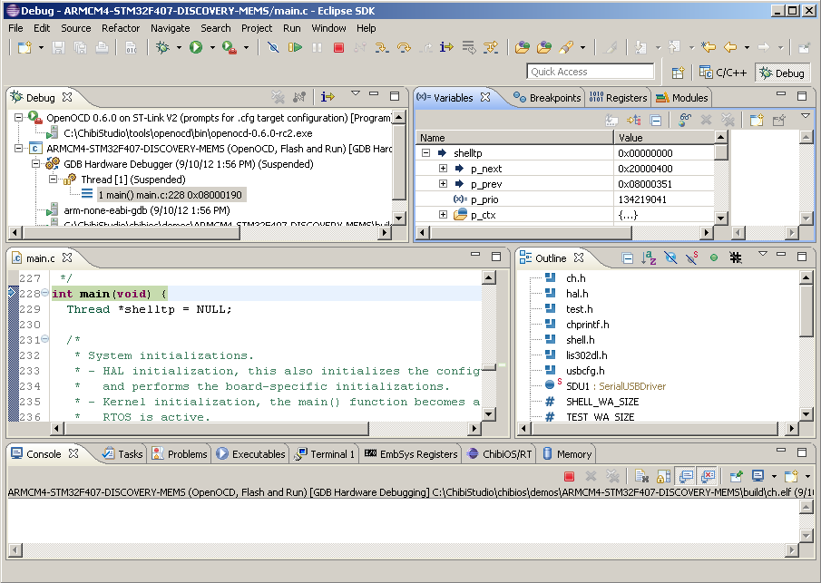
Debugging #3
Starting a debug session, Eclipse switches to debug mode

Slide 11
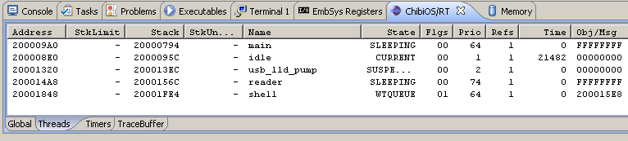
Debugging #4
Complete source-level debugger
  Single step and breakpoins both C-level and instruction level
  Module outline for fast source browsing
  Stack back trace
  Variables inspection
  CPU registers inspection
  MCU peripheral registers inspection
  RTOS status inspection via ChibiOS/RT debug plugin
Now, let the application run using the “continue” debug button

Slide 12
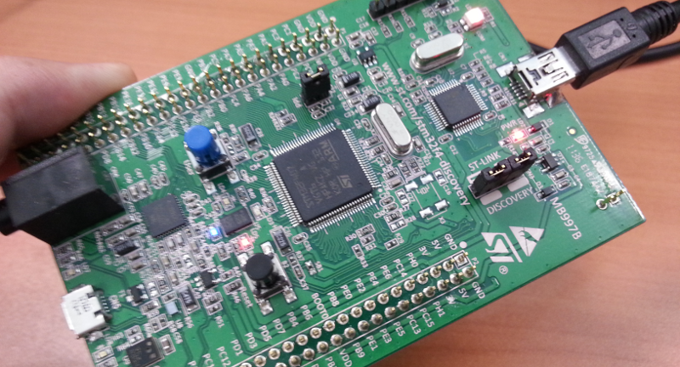
The Demo #1
Keeping the board in your hand move it around, the LEDs luminosity varies depending on the board orientation in 3D, this is done using:
  A dedicated “reader” thread to perform the processing
  A SPI port to read the on-board LIS302DL MEMS accelerometer
  Another SPI port to output the data read from the accelerometer
  Four PWM channels, one for each LED, that control the LEDs luminosity level
Everything in about 40 lines of code in a single function

Slide 13
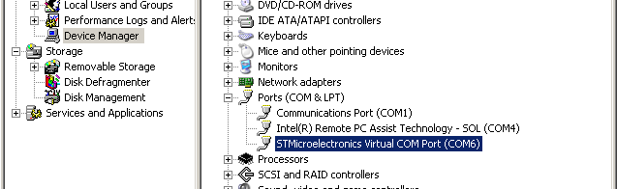
The Demo #2
It is not over yet, now connect the board to the PC using a micro USB cable, if the required USB driver is not already installed perform the driver installation
The device is recognized as a communication port COMx and appears in the Windows Device Manager as follow:

Slide 14
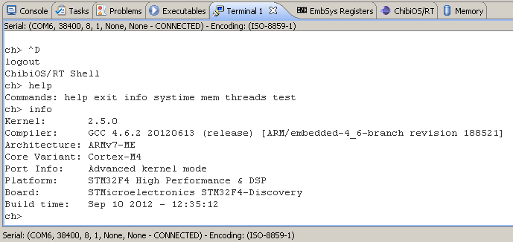
The Demo #3
Now connect the communication port using a terminal emulation program, in this case the “Terminal” window present in Chibi Studio, any other program would work
A simple command shell is ready to accept your commands

Slide 15
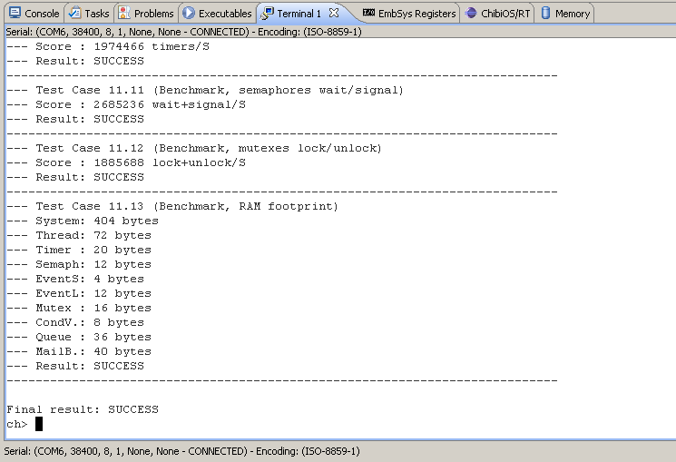
The Demo #4
From the shell, it is also possible to run the ChibiOS/RT test suite, benchmarks are included

Slide 16
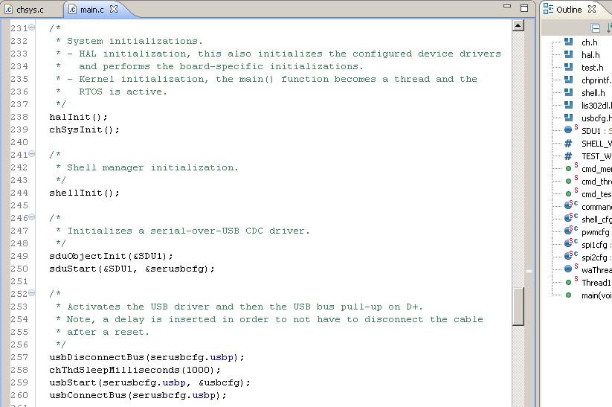
The Demo #5
Adding the shell and the USB only requires few lines of code, both are standard components in ChibiOS/RT

Slide 17

End of Demo

